Slide 1
Process Synchronization

Slide 2
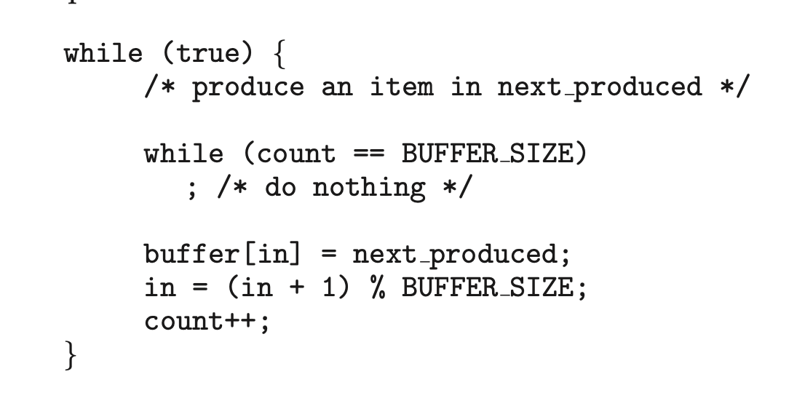
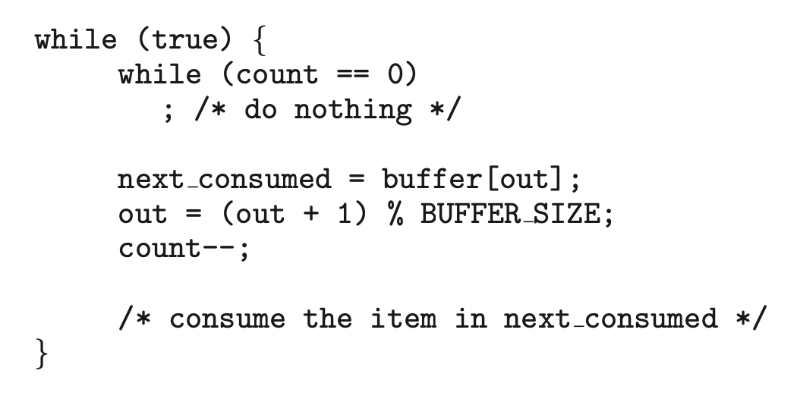
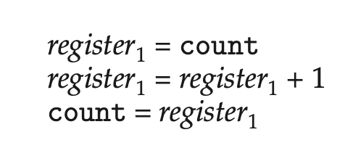
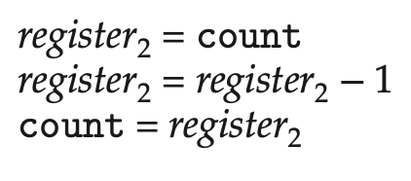
Process Synchronization

Slide 3
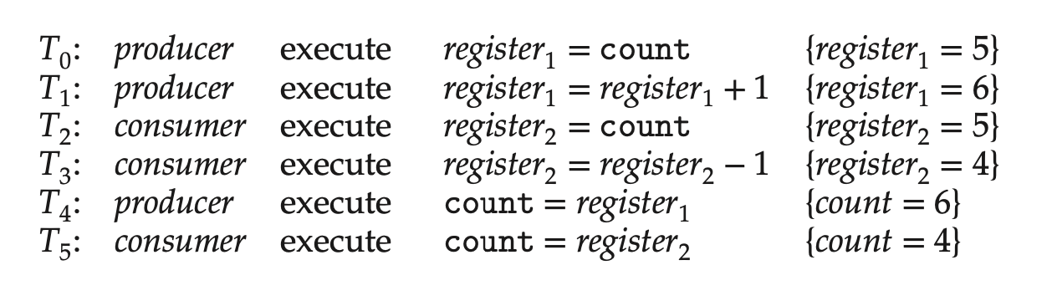

Slide 4
The Critical-Section Problem
1. Mutual exclusion. If process Pi is executing in its critical section, then no other processes can be executing in their critical sections.
2. Progress. If no process is executing in its critical section and some processes wish to enter their critical sections, then only those processes that are not executing in their remainder sections can participate in deciding which will enter its critical section next, and this selection cannot be postponed indefinitely.
3. Bounded waiting. There exists a bound, or limit, on the number of times that other processes are allowed to enter their critical sections after a process has made a request to enter its critical section and before that request is granted.

Slide 5
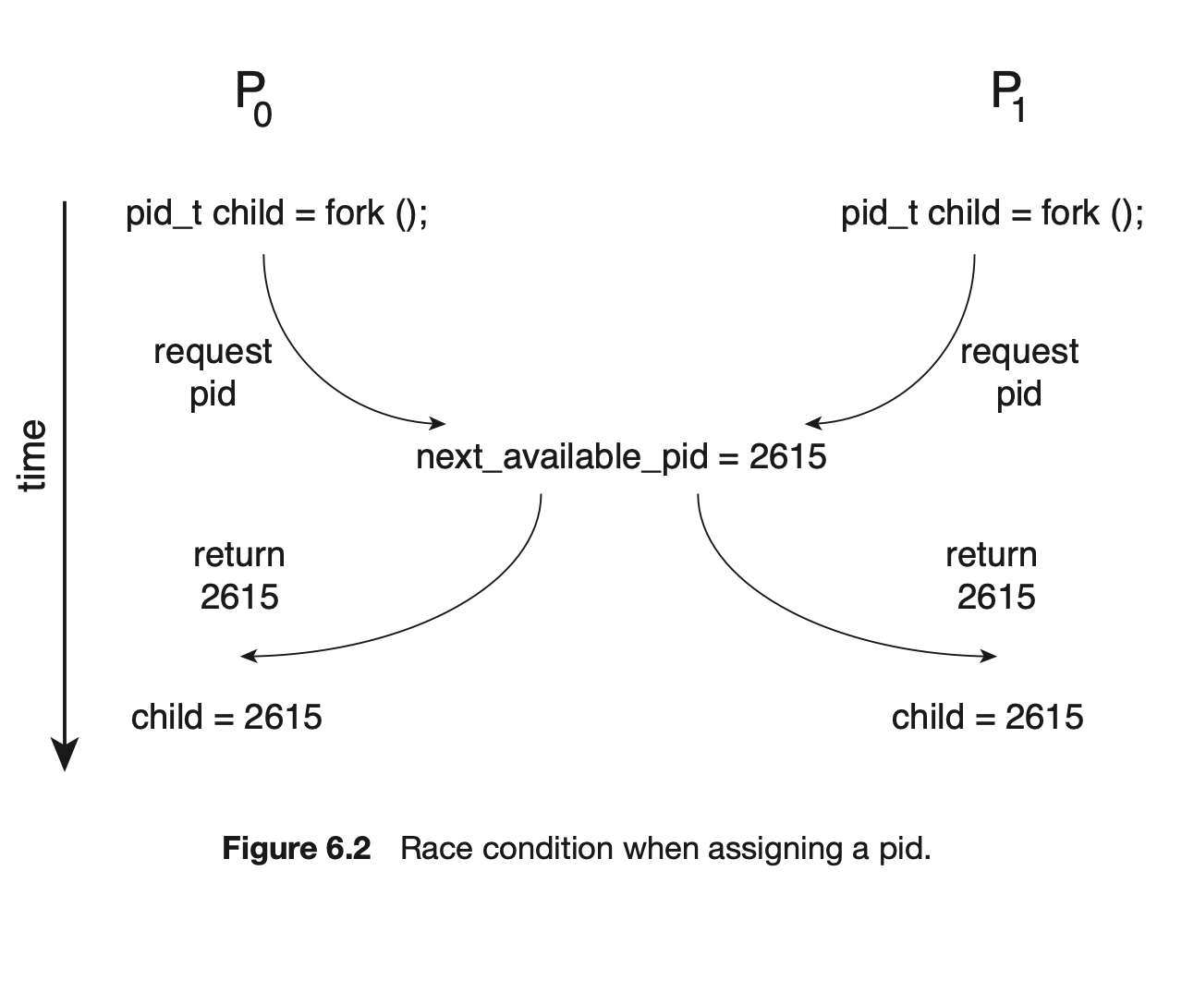

Slide 6
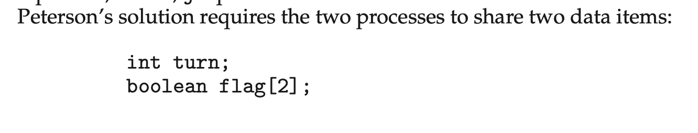
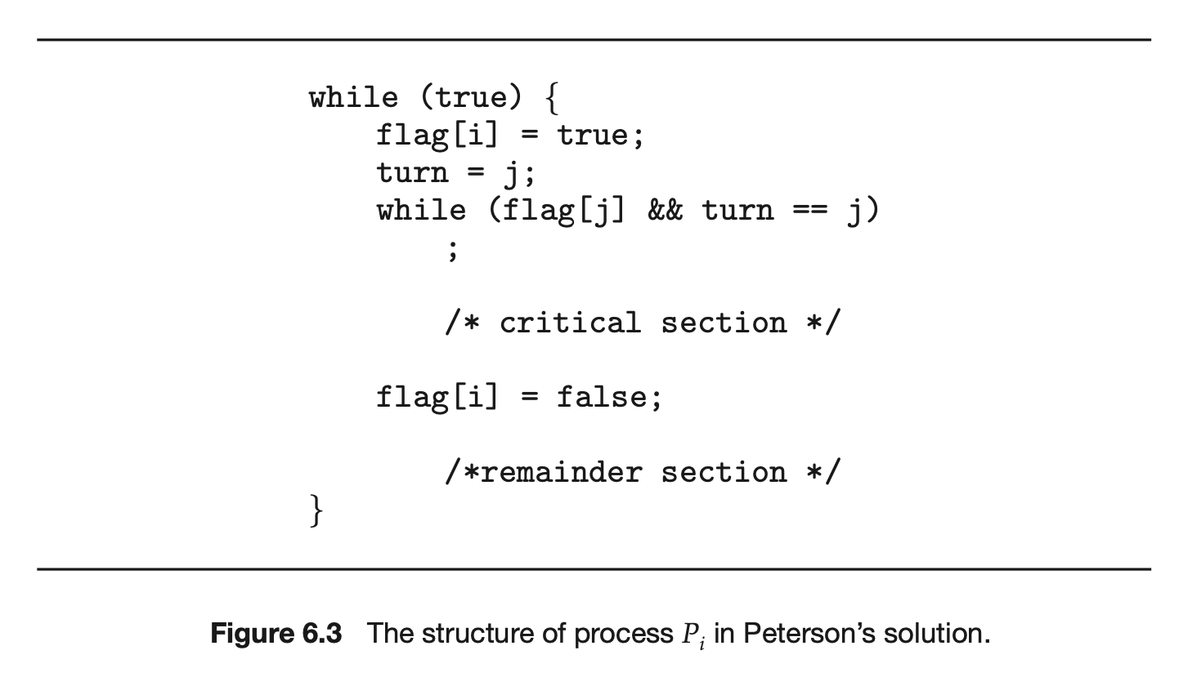
Peterson’s Solution
We now prove that this solution is correct. We need to show that:
Mutual exclusion is preserved.
The progress requirement is satisfied.
The bounded-waiting requirement is met.

Slide 7
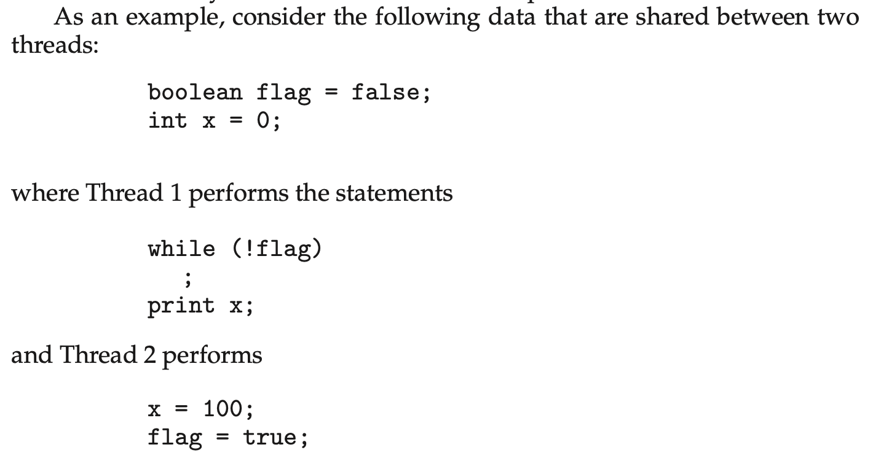

Slide 8
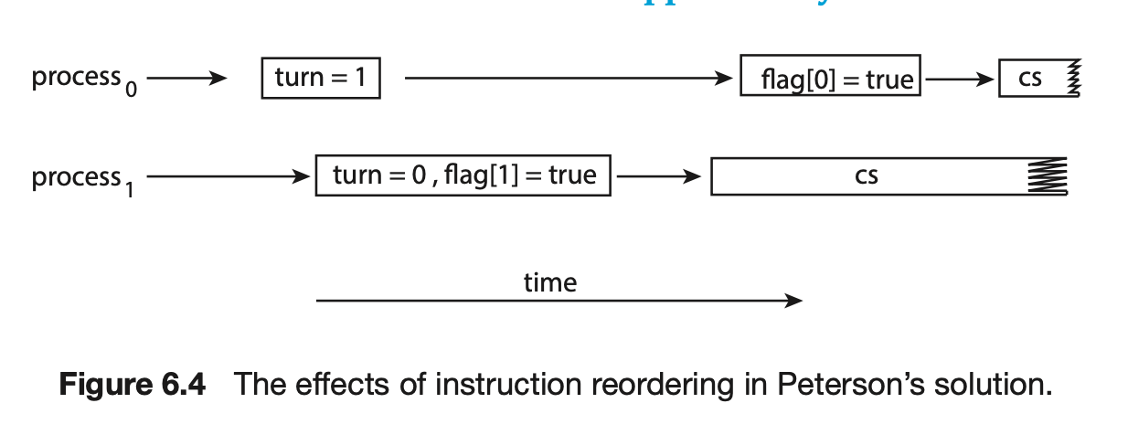

Slide 9
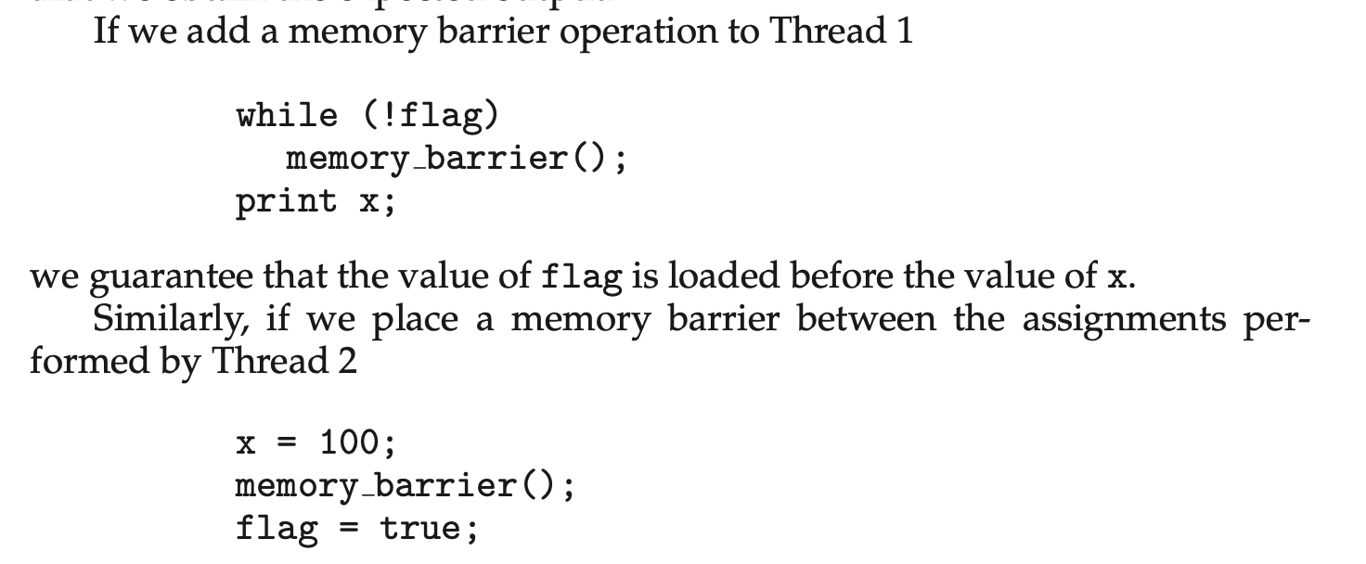
Memory Barriers
1. Strongly ordered, where a memory modification on one processor is immediately visible to all other processors.
2. Weakly ordered, where modifications to memory on one processor may not be immediately visible to other processors.

Slide 10
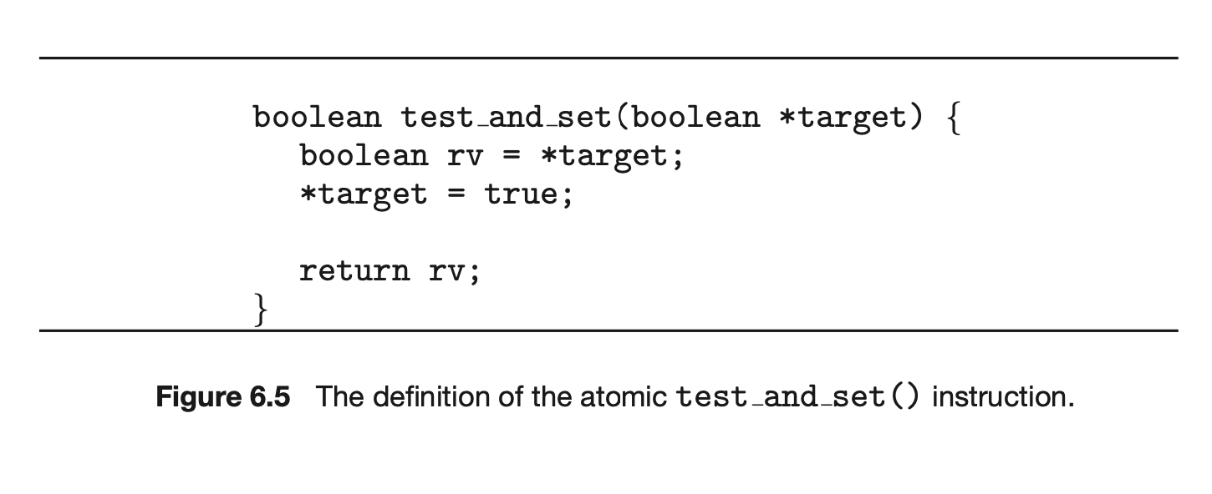
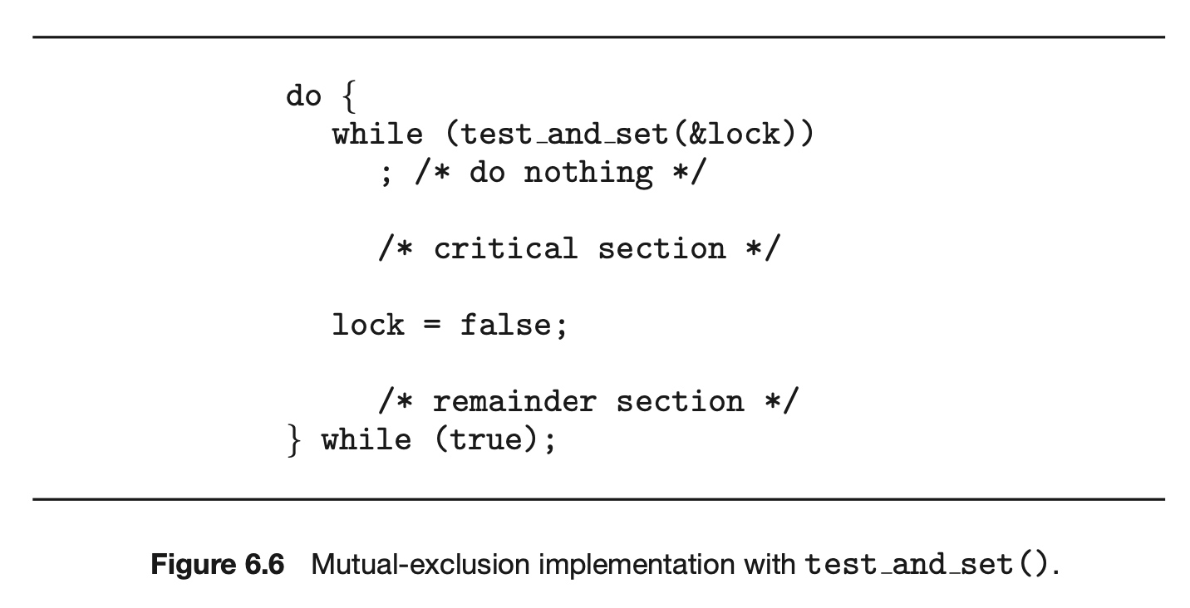
test_and_set()

Slide 11
test_and_set()
Property | Description
Mutual Exclusion | Achieved (only one process can set lock to true first)
Progress | As soon as lock is false, one waiting process can enter.
Bounded Waiting | Not guaranteed; a process could theoretically spin forever if unlucky
Busy Waiting | Yes — wastes CPU time in the while loop.

Slide 12
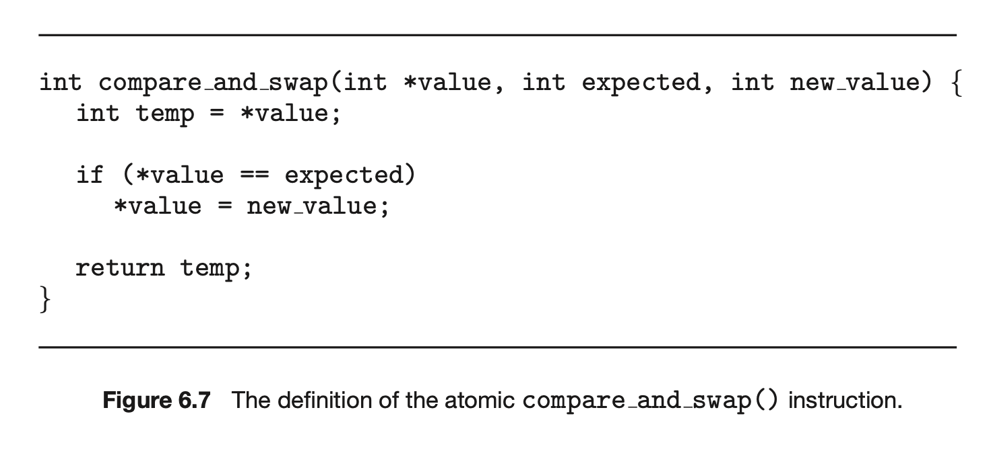
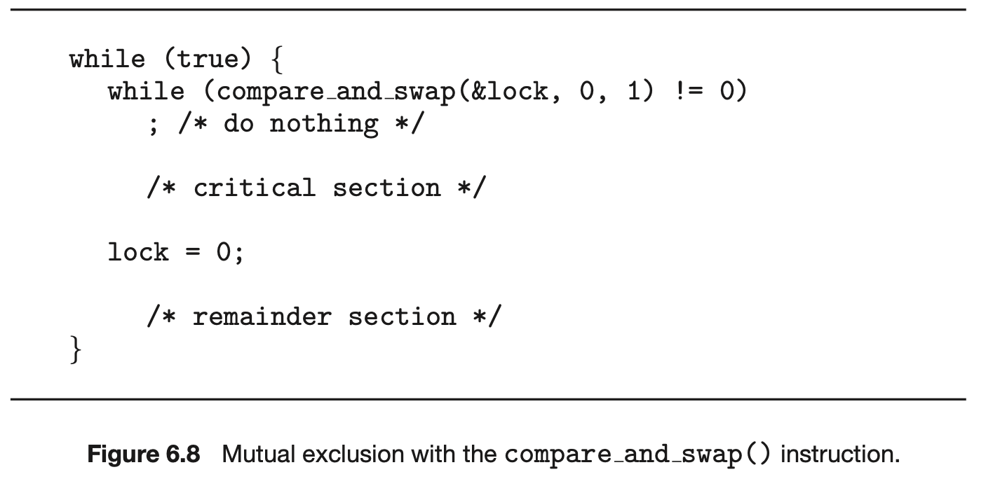
compare_and_swap()

Slide 13
compare_and_swap()
Property | Description
Mutual Exclusion | Yes — only one process sets lock to 1 successfully.
Progress | Yes — as soon as lock = 0, one waiting process will enter.
Bounded Waiting | Not guaranteed; a process could theoretically spin forever if unlucky
Busy Waiting | Yes — still spins in while loop.

Slide 14
Atomic variable
Atomic variables can be used in to ensure mutual exclusion in situations where there may be a data race on a single variable while it is being updated, as when a counter is incremented.
Counter
Integer

Slide 15
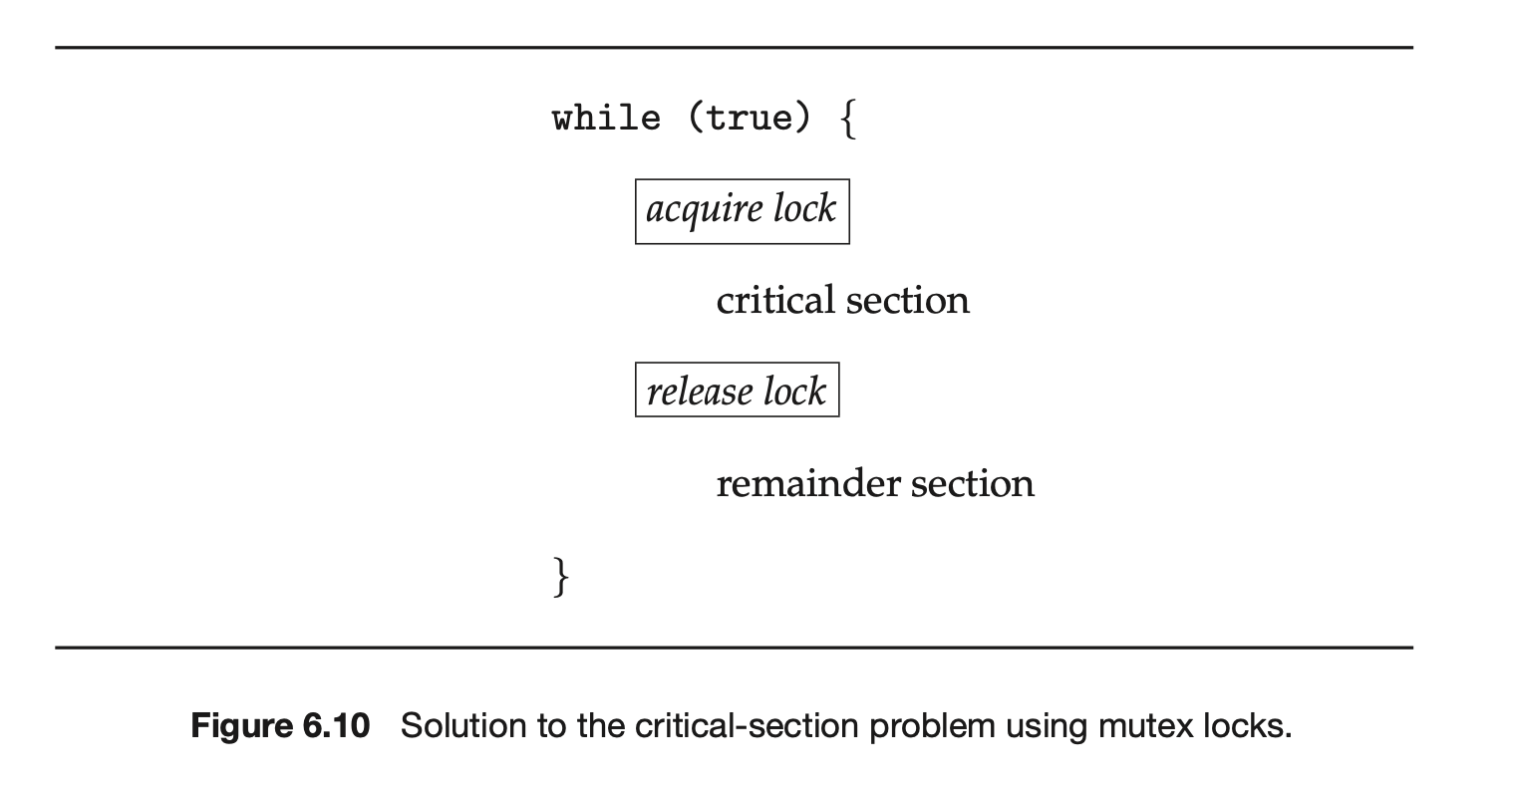
Mutex Locks
operating-system designers build higher-level software tools to solve the critical-section problem. The simplest of these tools is the mutex lock.

Slide 16
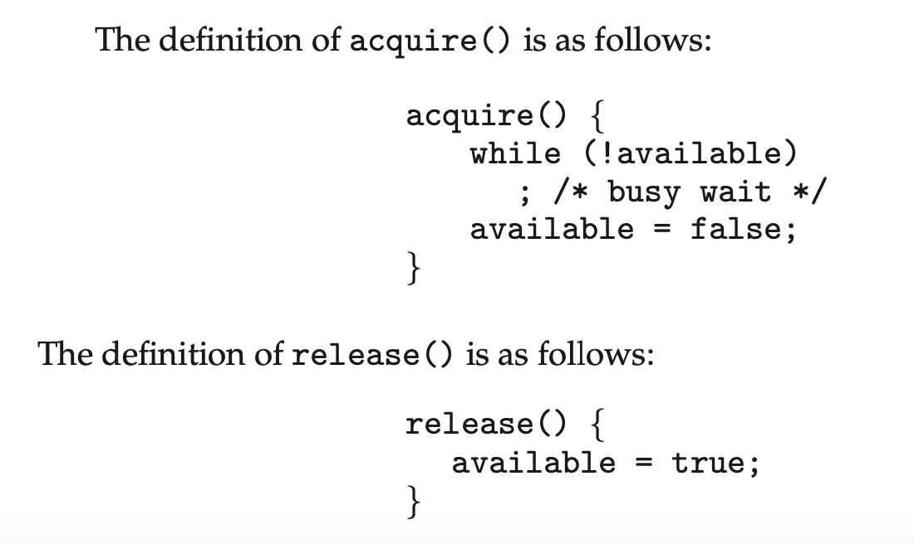
acquire() and release() functions

Slide 17
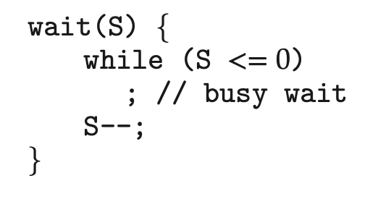
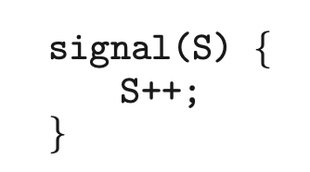
Semaphores
a more robust tool that can behave similarly to a mutex lock but can also provide more sophisticated ways for processes to synchronize their activities.
A semaphore S is an integer variable that, apart from initialization, is accessed only through two standard atomic operations: wait() and signal().

Slide 18
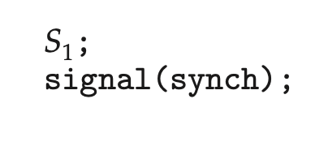
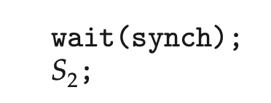
Semaphore Usage
In process P1, we insert the statements:
In process P2, we insert the statements:

Slide 19
Mechanism | Allows How Many states? | Wait Type | Managed By
Spinlock | 1 | Busy-wait | CPU (hardware)
Mutex | 1 | Blocking (sleep) | OS kernel
Semaphore | N | Blocking (sleep) | OS kernel

Slide 20
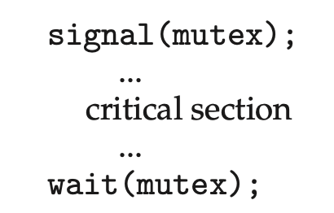
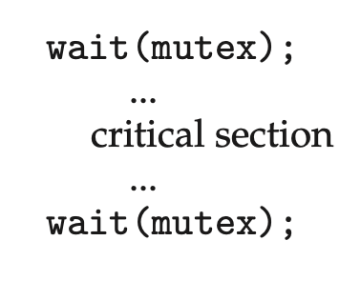
Monitors: high-level language constructs
Although semaphores provide a convenient and effective mechanism for process synchronization, using them incorrectly can result in timing errors that are difficult to detect:
Examples:

Slide 21
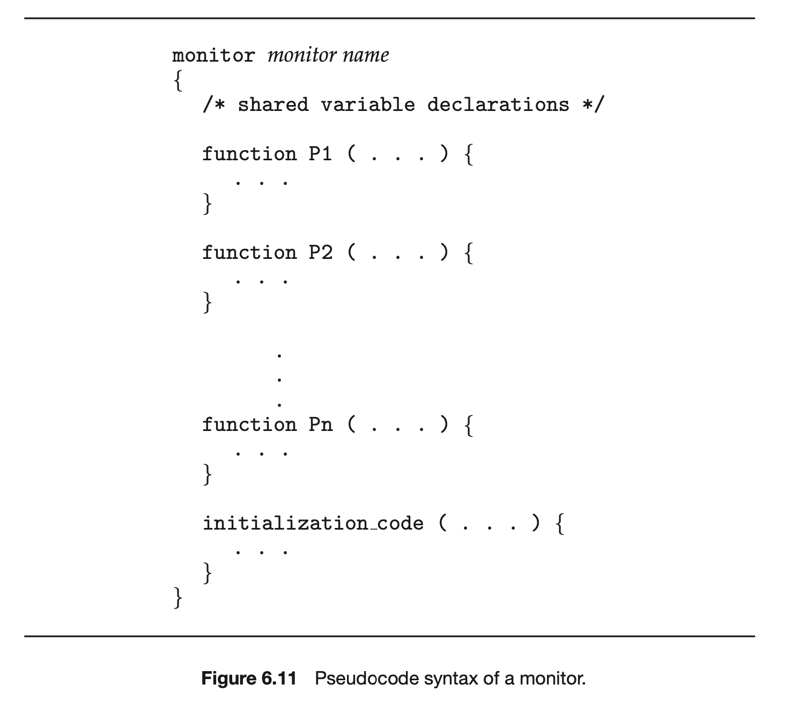
Monitors

Slide 22
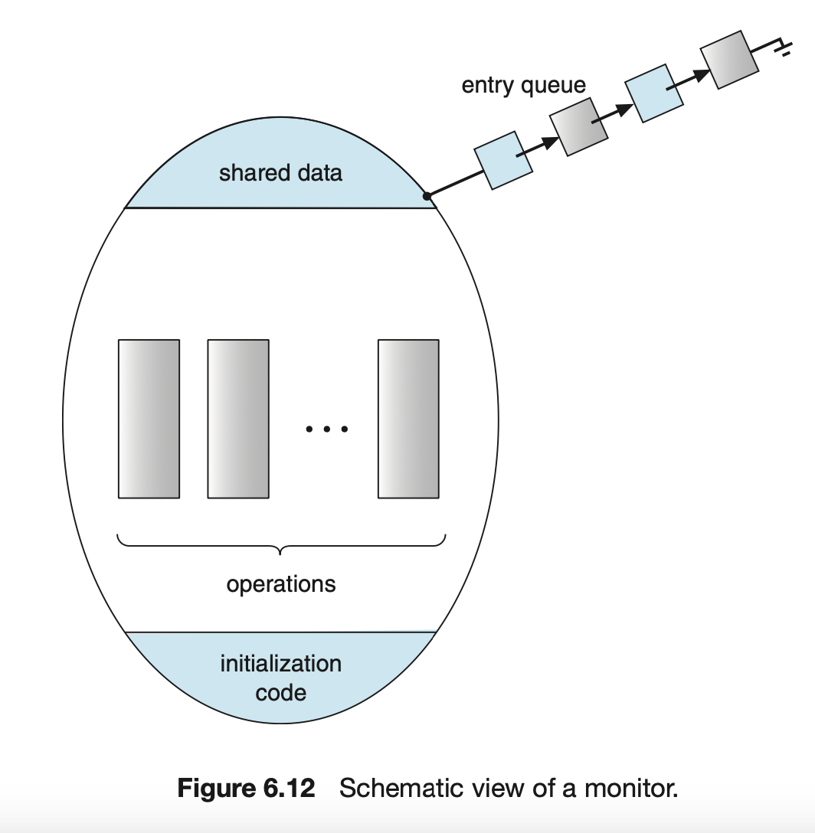
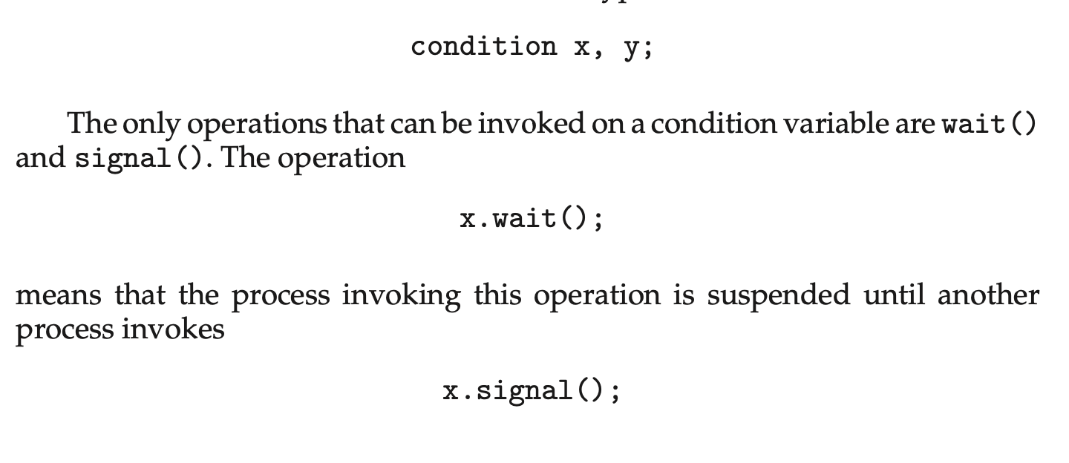
Monitors

Slide 23
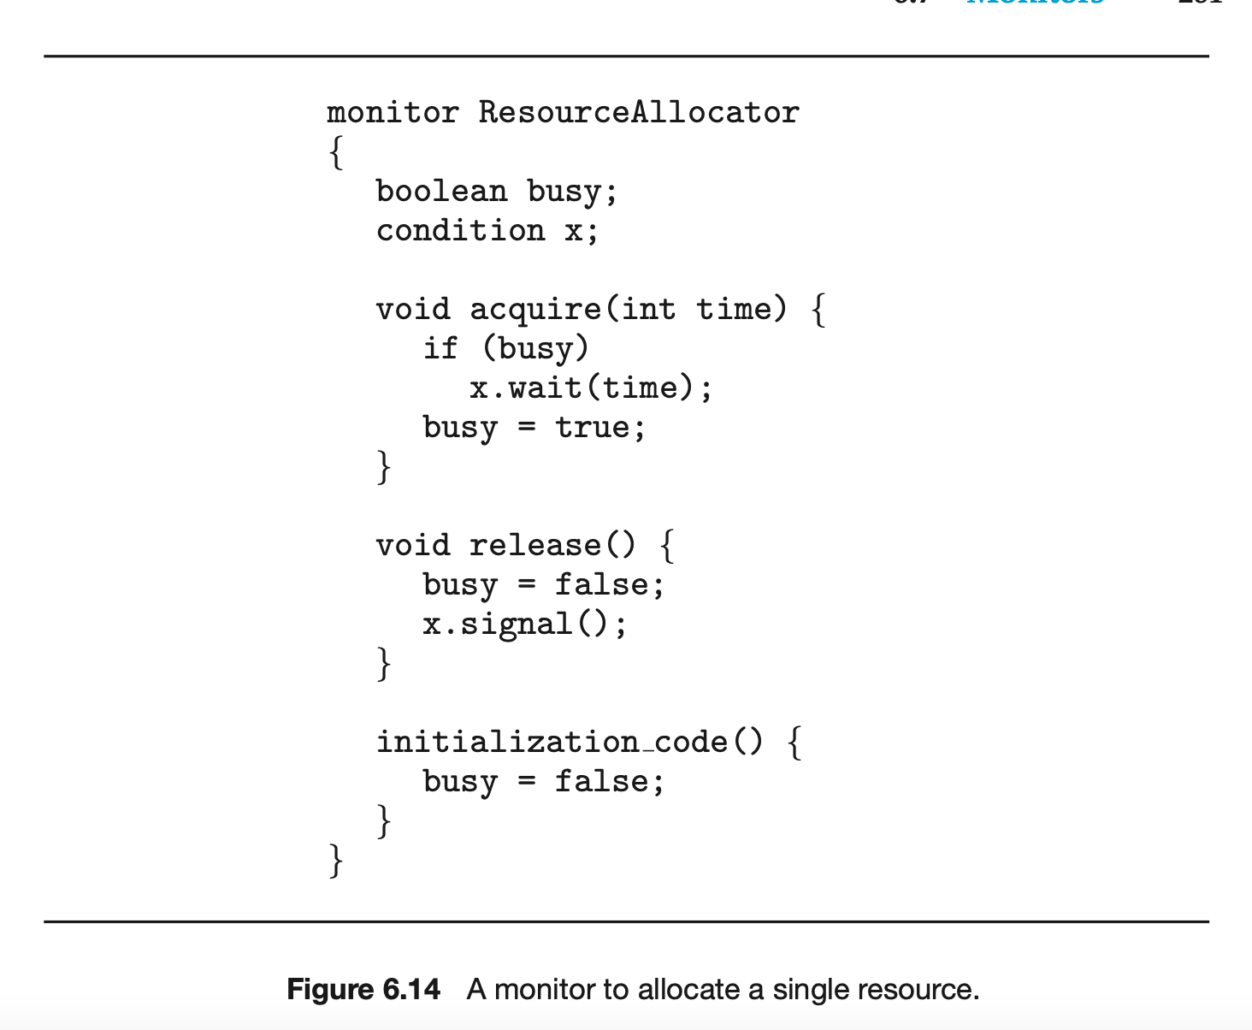

Slide 24
Monitors
High-level synchronization construct
Mutual exclusion + condition synchronization
Shared data, monitor procedures, condition variables
Mutual Exclusion: Automatic — only one thread active inside
Condition Variables: Allow waiting/signaling within the monitor
Languages Supporting Monitors: Java, C#, Modula-3, Concurrent Pascal

Slide 25
The Bounded-Buffer Problem (Producer–Consumer Problem)
There’s a buffer (shared memory area) with limited size N.
Producer threads generate data items and put them into the buffer.
Consumer threads remove items from the buffer and process them.
Synchronization is needed so that:
  Producers don’t add items when the buffer is full.
  Consumers don’t remove items when the buffer is empty.

Slide 26
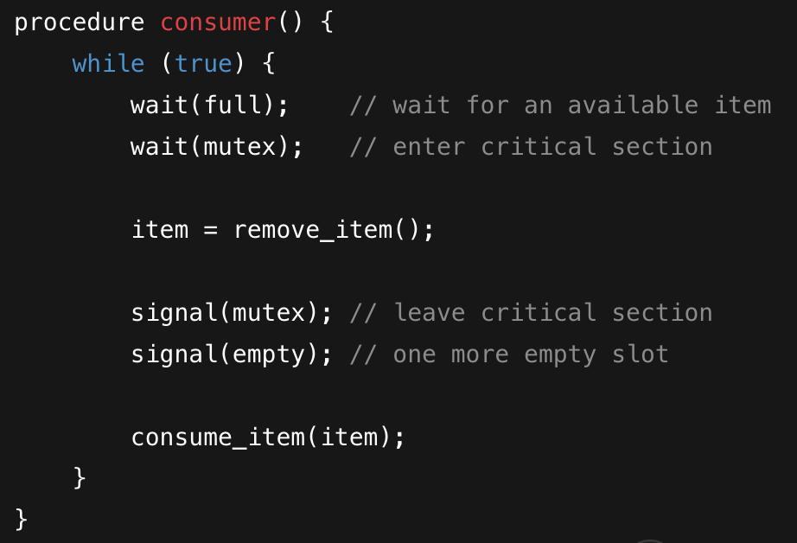
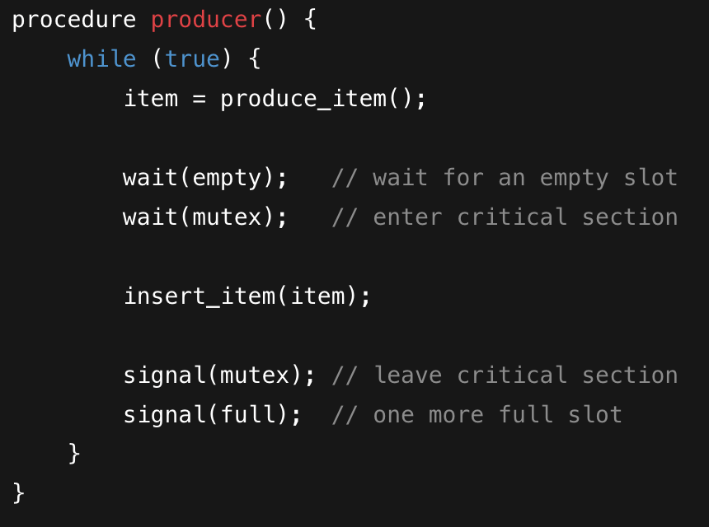
Pseudocode for addressing Bounded-Buffer Problem
semaphore mutex = 1;
semaphore empty = N;
semaphore full = 0;

Slide 27
Initial states are empty = 3, full = 0, mutex = 1
buffer = [ _ , _ , _ ]
Step 1: Producer P1 produces an item
Action | empty | full | mutex | Buffer
P1: wait(empty) | 2 | 0 | 1 | [ _ , _ , _ ]
P1: wait(mutex) | 2 | 0 | 0 | enters critical section
P1: insert_item(X1) | 2 | 0 | 0 | [ X1 , _ , _ ]
P1: signal(mutex) | 2 | 0 | 1 | leaves CS
P1: signal(full) | 2 | 1 | 1 | buffer now has one full slot

Slide 28
Step 2: Producer P2 produces another item
current states are empty = 2, full = 1, mutex = 1
Action | empty | full | mutex | Buffer
P2: wait(empty) | 1 | 1 | 1 | [ X1 , _ , _ ]
P2: wait(mutex) | 1 | 1 | 0 | enters critical section
P2: insert_item(X2) | 1 | 1 | 0 | [ X1 , X2 , _ ]
P2: signal(mutex) | 1 | 1 | 1 | leaves CS
P2: signal(full) | 1 | 2 | 1 | [ X1 , X2 , _ ]

Slide 29
Step 3: Consumer C1 starts consuming
current states are empty = 1, full = 2, mutex = 1
Action | empty | full | mutex | Buffer
C1: wait(full) | 1 | 1 | 1 | checks full slot
C1: wait(mutex) | 1 | 1 | 0 | enters CS
C1: remove_item(X1) | 1 | 1 | 0 | [ _ , X2 , _ ]
C1: signal(mutex) | 1 | 1 | 1 | leaves CS
C1: signal(empty) | 2 | 1 | 1 | one slot freed

Slide 30
Step 4: Producer P1 produces another item
current states are empty = 2, full = 1, mutex = 1
Action | empty | full | mutex | Buffer
P1: wait(empty) | 1 | 1 | 1 | [ _ , X2 , _ ]
P1: wait(mutex) | 1 | 1 | 0 | enters CS
P1: insert_item(X3) | 1 | 1 | 0 | [ X3 , X2 , _ ]
P1: signal(mutex) | 1 | 1 | 1 | leaves CS
P1: signal(full) | 1 | 2 | 1 | [ X3 , X2 , _ ]

Slide 31
Step 5: Consumer C1 consumes again
current states are empty = 1, full = 2, mutex = 1
Action | empty | full | mutex | Buffer
C1: wait(full) | 1 | 1 | 1 | has full slot
C1: wait(mutex) | 1 | 1 | 0 | enters CS
C1: remove_item(X2) | 1 | 1 | 0 | [ X3 , _ , _ ]
C1: signal(mutex) | 1 | 1 | 1 | leaves CS
C1: signal(empty) | 2 | 1 | 1 | frees one slot

Slide 32
Readers–Writers Problem
A shared database (like a file or table):
Readers only read the data.
Writers modify the data.
We must ensure:
No writer is writing while any reader is reading.
Multiple readers can read simultaneously (no conflict).
But only one writer can write at a time.

Slide 33
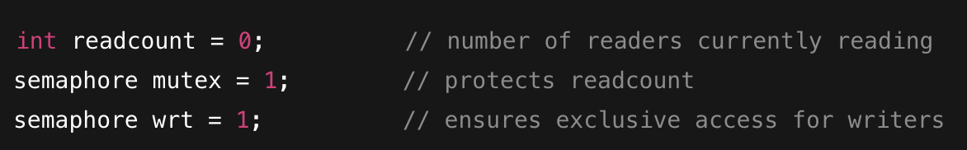
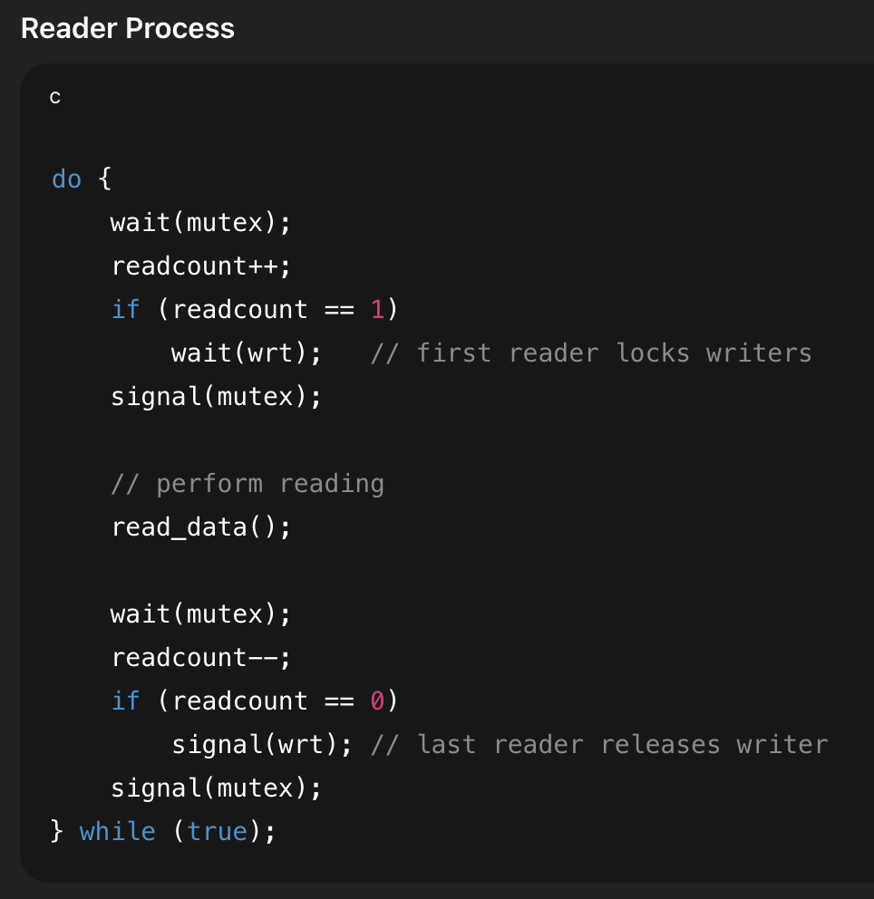
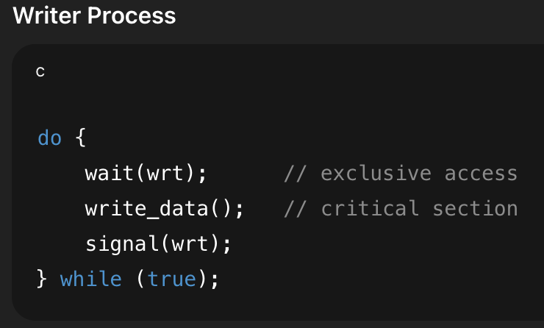
Pseudocode for addressing Readers–Writers Problem

Slide 34
Step 1: R2 starts reading
Initial states are readcount = 0, mutex = 1, wrt = 1
Now R1 is reading, writers are blocked (wrt = 0).
Step | Action | readcount | mutex | wrt | Notes
1 | R1 executes wait(mutex) | 0 | 0 | 1 | enters mutex
2 | R1 increments readcount = 1 | 1 | 0 | 1 | first reader
3 | Since readcount == 1, R1 executes wait(wrt) | 1 | 0 | 0 | locks writers
4 | R1 executes signal(mutex) | 1 | 1 | 0 | leaves mutex

Slide 35
Step 1: R2 starts reading
current states are readcount = 1, mutex = 1, wrt = 0
Both R1 and R2 are reading.
Writers still blocked (wrt = 0).
Step | Action | readcount | mutex | wrt | Notes
5 | R2 executes wait(mutex) | 1 | 0 | 0 | enters mutex
6 | R2 increments readcount = 2 | 2 | 0 | 0 | not first reader, no wait(wrt)
7 | R2 increments readcount = 2 | 2 | 1 | 0 | leaves mutex

Slide 36
Step 3: W1 tries to write
current states are readcount = 2, mutex = 1, wrt = 0
Writer is blocked until all readers finish.
Step | Action | readcount | mutex | wrt | Notes
8 | W1 executes wait(wrt) | 2 | 1 | 0 | must wait (blocked)

Slide 37
Step 4: R1 finishes reading
current states are readcount = 2, mutex = 1, wrt = 0
R2 still reading; W1 still waiting.
Step | Action | readcount | mutex | wrt | Notes
9 | R1 executes wait(mutex) | 2 | 0 | 0 | enters mutex
10 | R1 decrements readcount = 1 | 1 | 0 | 0 | still one reader left
11 | No signal(wrt) (not last reader) | 1 | 0 | 0 | writers still blocked
12 | R1 executes signal(mutex) | 1 | 1 | 0 | leaves mutex

Slide 38
Step 5: R2 finishes reading;
Current states are readcount = 1; mutex = 1; wrt = 0
No readers left — now W1 can proceed.
Step | Action | read count | mutex | wrt | Notes
13 | R2 executes wait(mutex) | 1 | 0 | 0 | enters mutex
14 | R2 decrements readcount = 0 | 0 | 0 | 0 | last reader
15 | Since readcount == 0, R2 executes signal(wrt) | 0 | 0 | 1 | writers unblocked
16 | R2 executes signal(mutex) | 0 | 1 | 1 | leaves mutex

Slide 39
Step 6: W1 writes
current states are readcount = 0, mutex = 1, wrt = 1
Writer done.
Now other readers/writers may proceed.
Step | Action | readcount | mutex | wrt | Notes
17 | W1 (previously blocked) now executes wait(wrt) | 0 | 1 | 0 | gains exclusive access
18 | W1 writes data | 0 | 1 | 0 | critical section
19 | W1 executes signal(wrt) | 0 | 1 | 1 | releases lock

Slide 40
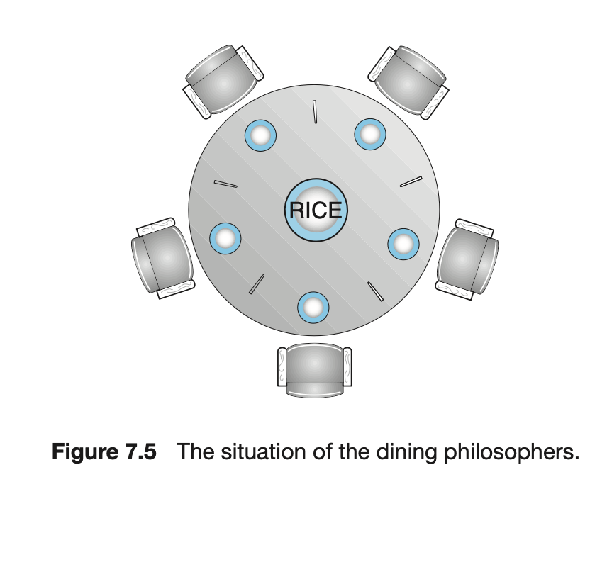
Dining-Philosophers Problem
Five philosophers sit around a circular table.
Between each pair, there is one chopstick.
Each philosopher needs two chopsticks to eat.
Problem: prevent deadlock and starvation.

Slide 41
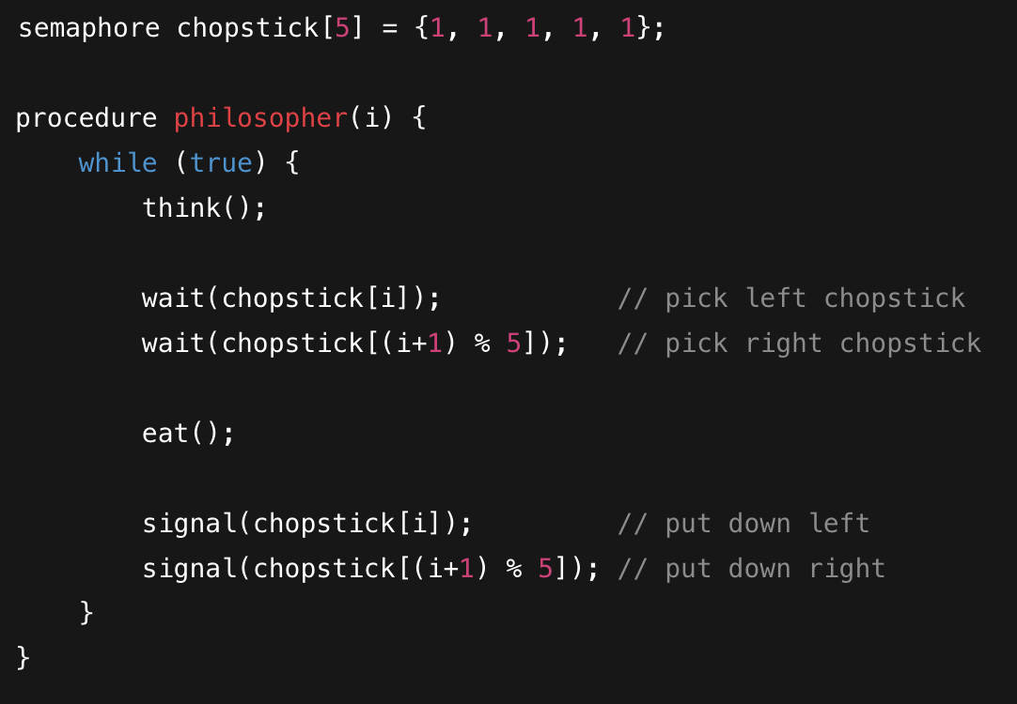
Naive Solution (with Deadlock Risk)
If all philosophers pick their left chopstick at the same time
means: no one can get the right one
means: deadlock.

Slide 42
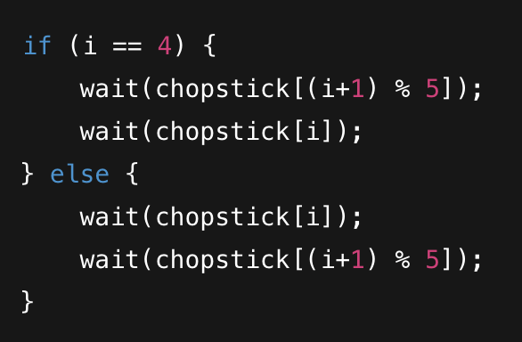
Avoiding Deadlock (One Common Fix)
Let one philosopher pick up chopsticks in reverse order:
Ensures asymmetry and avoids circular wait condition.

Slide 43
Several possible solutions
Several possible remedies to the deadlock problem are the following:
Allow at most four philosophers to be sitting simultaneously at the table.
Allow a philosopher to pick up her chopsticks only if both chopsticks are available (to do this, she must pick them up in a critical section).
Use an asymmetric solution—that is,an odd-numbered philosopher picks up first her left chopstick and then her right chopstick, whereas an even- numbered philosopher picks up her right chopstick and then her left chopstick.

Slide 44
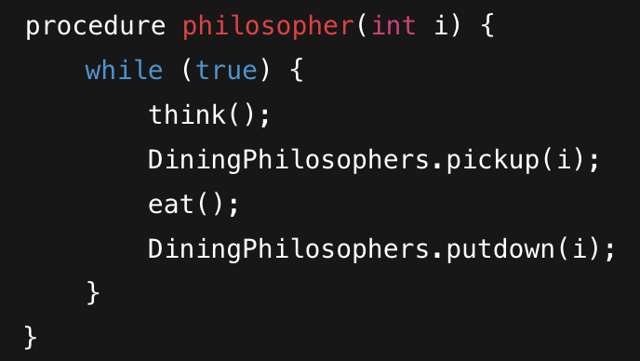
Monitor Solution
Each philosopher must:
Think for a while,
Request to eat (only when both chopsticks available),
Release chopsticks when done.
We’ll use a state variable per philosopher and condition variables to manage who can eat.

Slide 45
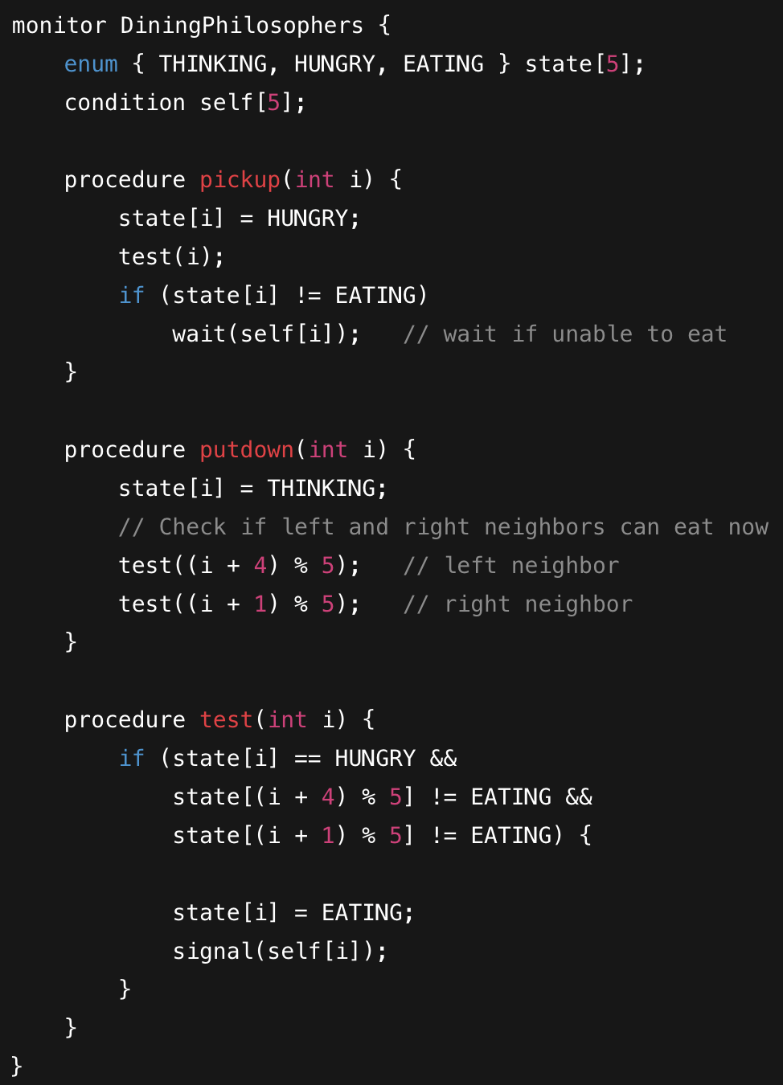

Slide 46
Time | Philosopher | Action | State Array (T=Thinking, H=Hungry, E=Eating) | Explanation
t0 | 0 | HUNGRY | H T T T T | 0 can eat (no neighbors eating)
t1 | 0 | EATING | E T T T T
t2 | 1 | HUNGRY | E H T T T | 1 cannot eat (left neighbor 0 is eating)
t3 | 2 | HUNGRY | E H H T T | 2 cannot eat (neighbor 1 HUNGRY, 0 EATING)
t4 | 0 | puts down | T H H T T | test(1) and test(4): now 1 can eat
t5 | 1 | EATING | T E H T T
t6 | 1 | puts down | T T H T T | test(0) and test(2): now 2 can eat
t7 | 2 | EATING | T T E T T

Slide 47
https://www.placementpreparation.io/blog/operating-system-project-ideas-for-beginners/#basic-file-compression-tool

